Slide 1





Simulations of a Liquid Xenon Positron Target
Max Varverakis, SLAC/Cal Poly
Spencer Gessner, SLAC
Nathan Majernik, SLAC
Silviu Dusa, JLab
Sanjeev Chauhan , Duke
Robert Holtzapple, Cal Poly Hiroki Fujii, Nishina Center
US-Japan Collaboration Meeting, Feb 26, 2025, SLAC

Slide 2
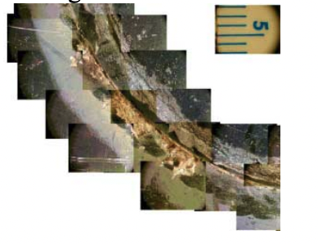

Issues with positron production for linear colliders
Conventional Scheme Direct high energy electrons (~10 GeV) into a high-Z target.
Target Requirements 1. High-Z 2. Short radiation length (≤ (1 cm)) 3. High energy deposition threshold
Established (Solid) Target Materials 1. Tantalum (Ta) with radiation length L_{RL}~ 0.4094 cm. 2. Tungsten-Rhenium (W₇₅Re₂₅) alloy with radiation length L_{RL}~ 0.3430 cm.
Problem Producing positrons generates lots of thermal energy. Future linear colliders require greater positron production rates ⇒ more heat!
Result Solid targets degrade over time [1] ⇒ Solid targets have shortened operational lifespans.
Degraded section of SLC positron target
ANALYSIS OF BEAM-INDUCED DAMAGE TO THE SLC POSITRON PRODUCTION TARGET | Fig 3b
https://accelconf.web.cern.ch/p01/PAPERS/WPAH019.PDF
This will become more apparent for future collider usage.
⇒ Current techniques may require additional measures to account for this

Slide 3
Current techniques to mitigate target damage
Solid Targets 1. Spin the target to avoid the electron beam impinging on the same spot each beam pulse. Problems: (i) Strict motor requirements. (ii) Induced eddy currents ⇒ large power requirements [2].
2. Integrate a (liquid) cooling system to maintain suitable target temperatures. Problems: Solid target cooling mechanisms can get complicated (how to transport coolant to/from target without obstructing electron beam?)
Liquid Target Alternatives Various liquid targets have been explored for use in the conventional positron production scheme, such as: 1. Mercury 2. Lead/PbBi Problems: (i) Concerns about proper containment. (ii) These substances are toxic which further complicates effective usage.
US-Japan Collaboration Meeting, Feb 26, 2025

Slide 4
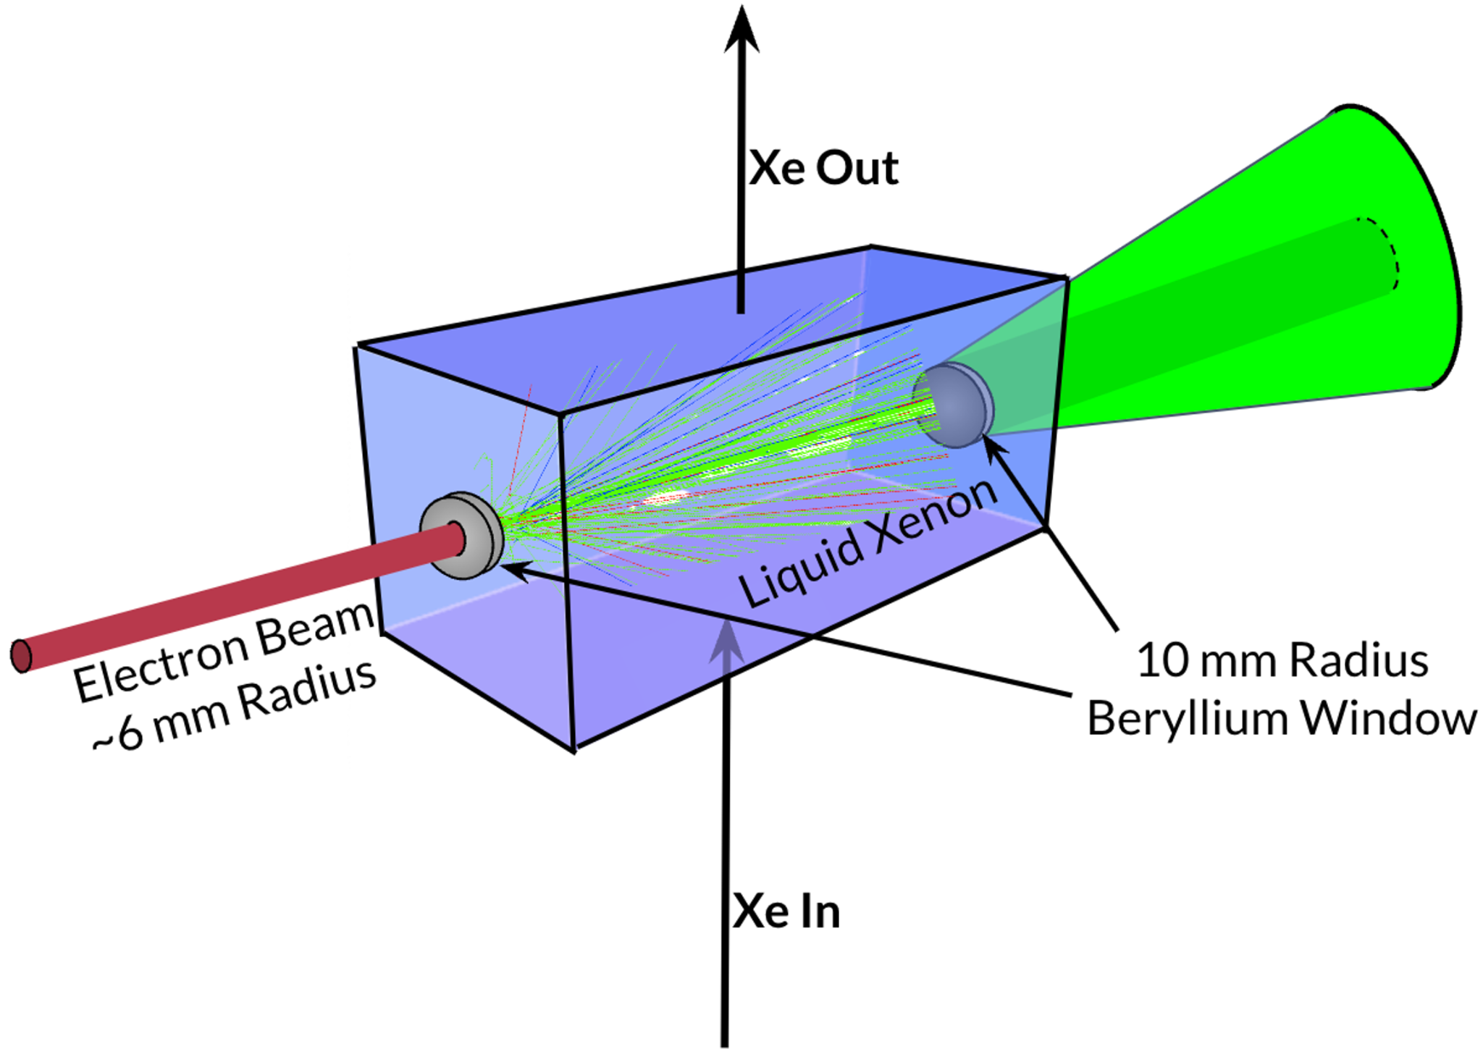
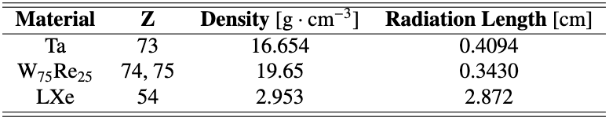
Potential solution: liquid xenon
Use a liquid xenon (LXe) positron target!
Why? 1. Xenon is nonreactive (noble gas) 2. It’s high-Z 3. Dense liquid at relatively high temperatures (~165 K) 4. LXe has a short radiation length (for a nonmetal) 5. LXe is non-toxic 6. High energy deposition threshold 7. LXe is continually refreshed and not susceptible to degradation 8. Cooling/recycling of LXe occurs away from IP 9. Positron yields are comparable with solid targets
Schematic of the liquid xenon (LXe) positron target setup. Electron beam enters from the left, passing through a beryllium window into the vessel of LXe. The resulting EM shower exits through an identical beryllium window.
US-Japan Collaboration Meeting, Feb 26, 2025
Notable properties for various target materials [3, 4, 5].

Slide 5
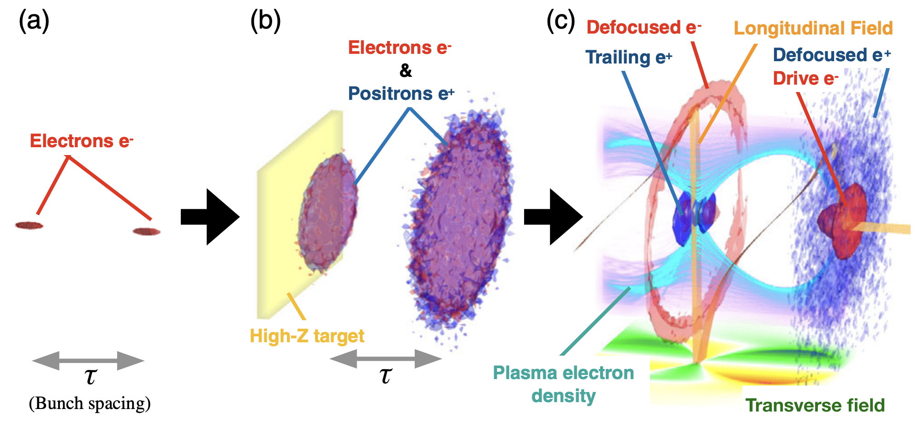
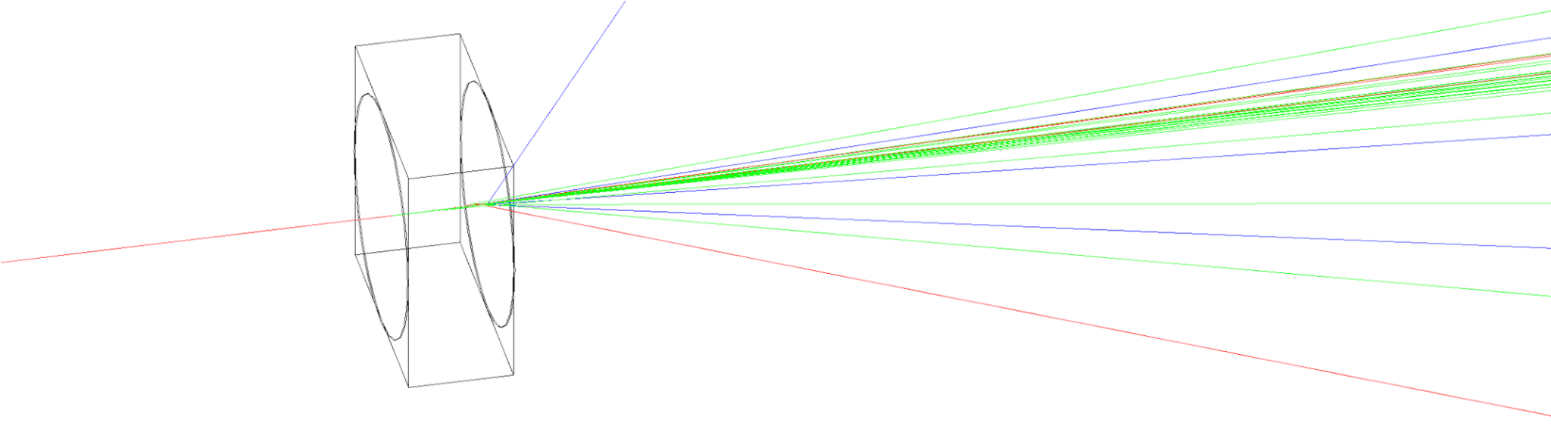
GEANT4 simulations of positron sources
We simulated positron production in LXe, Ta, and W₇₅Re₂₅ targets using GEANT4 [6].
The simulation serves as a starting point for comparing LXe to well-established solid positron sources.
The simulation consisted of:
N₀= 10,000 macro particles onto the target
Incoming beam spot size of ~6 mm radius
3 GeV, 6 GeV, and 10 GeV beam energies
Simulated over 0.5 to 8 radiation lengths of each material
Particle selection criteria were applied to replicate capture section losses
Fujii, et al., Positron beam extraction from an electron-beam-driven
plasma wakefield accelerator, Phys. Rev. Accel. Beams, 22 (9) (2019), 10.1103/physrevaccelbeams.22.091301
Single-particle EM shower generated in GEANT4. Red, blue, and green lines indicate e– , e⁺ , and photon trajectories, respectively.
US-Japan Collaboration Meeting, Feb 26, 2025

Slide 6
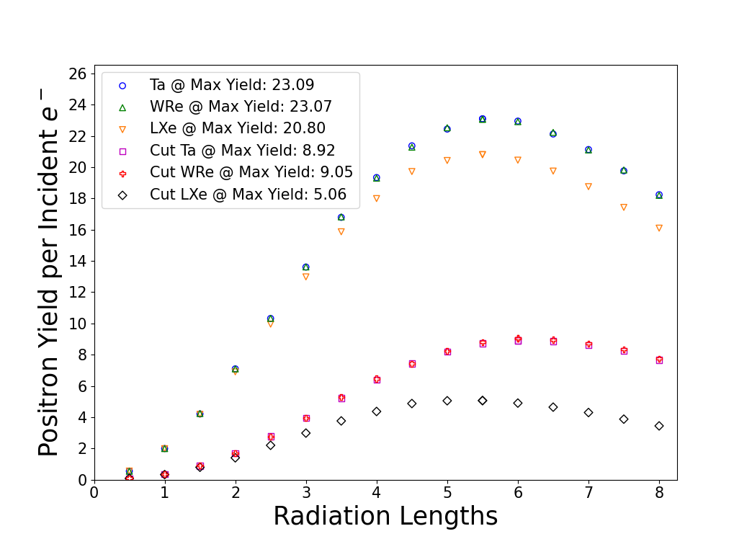
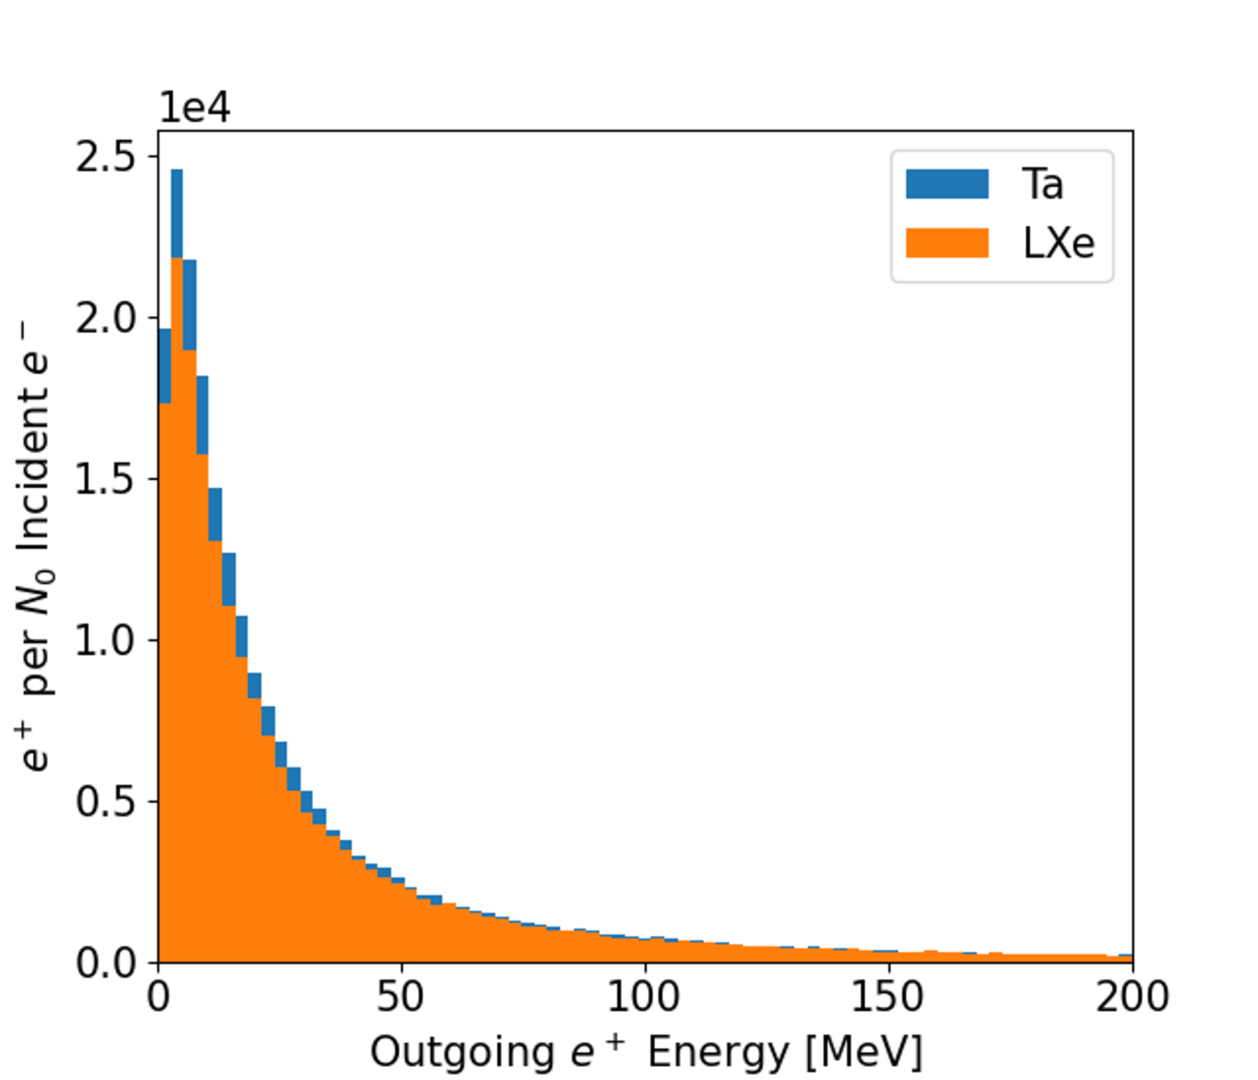
Comparing LXe to Ta and W₇₅Re₂₅
Comparable Yields
Similar Energy Spectra
Incident electron beam energy: 10 GeV.
The cuts applied to the outgoing positrons require: 1. their energy is greater than 2 MeV and less than 22 MeV 2. a transverse offset less than 10 mm.
Energy spectrum of positrons generated in 5.5 radiation length LXe and Ta targets by a 10 GeV electron beam.
***We omit the W₇₅Re₂₅ spectrum because it closely matches the Ta spectrum.
US-Japan Collaboration Meeting, Feb 26, 2025
Varverakis, et al. (2023). A liquid xenon positron target concept, NIM-A (Vol. 1053, p. 168329). 10.1016/j.nima.2023.168329

Slide 7
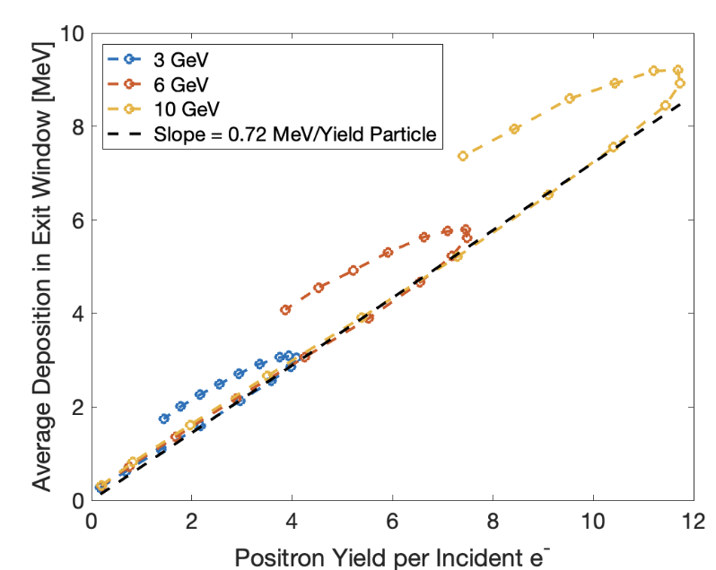
Yield and exit window energy deposit correlation
Energy deposition in the beryllium exit window as a function of particle yield for three different input electron beam energies.
***The yield value shown is after the particle selection cuts are applied.
There is a linear dependence on energy deposited in the exit window per yield particle up to the maximum yield for each incoming beam energy.
Yield ⇔ Window Energy Dep.
US-Japan Collaboration Meeting, Feb 26, 2025
Varverakis, et al. (2023). A liquid xenon positron target concept, NIM-A (Vol. 1053, p. 168329). 10.1016/j.nima.2023.168329

Slide 8
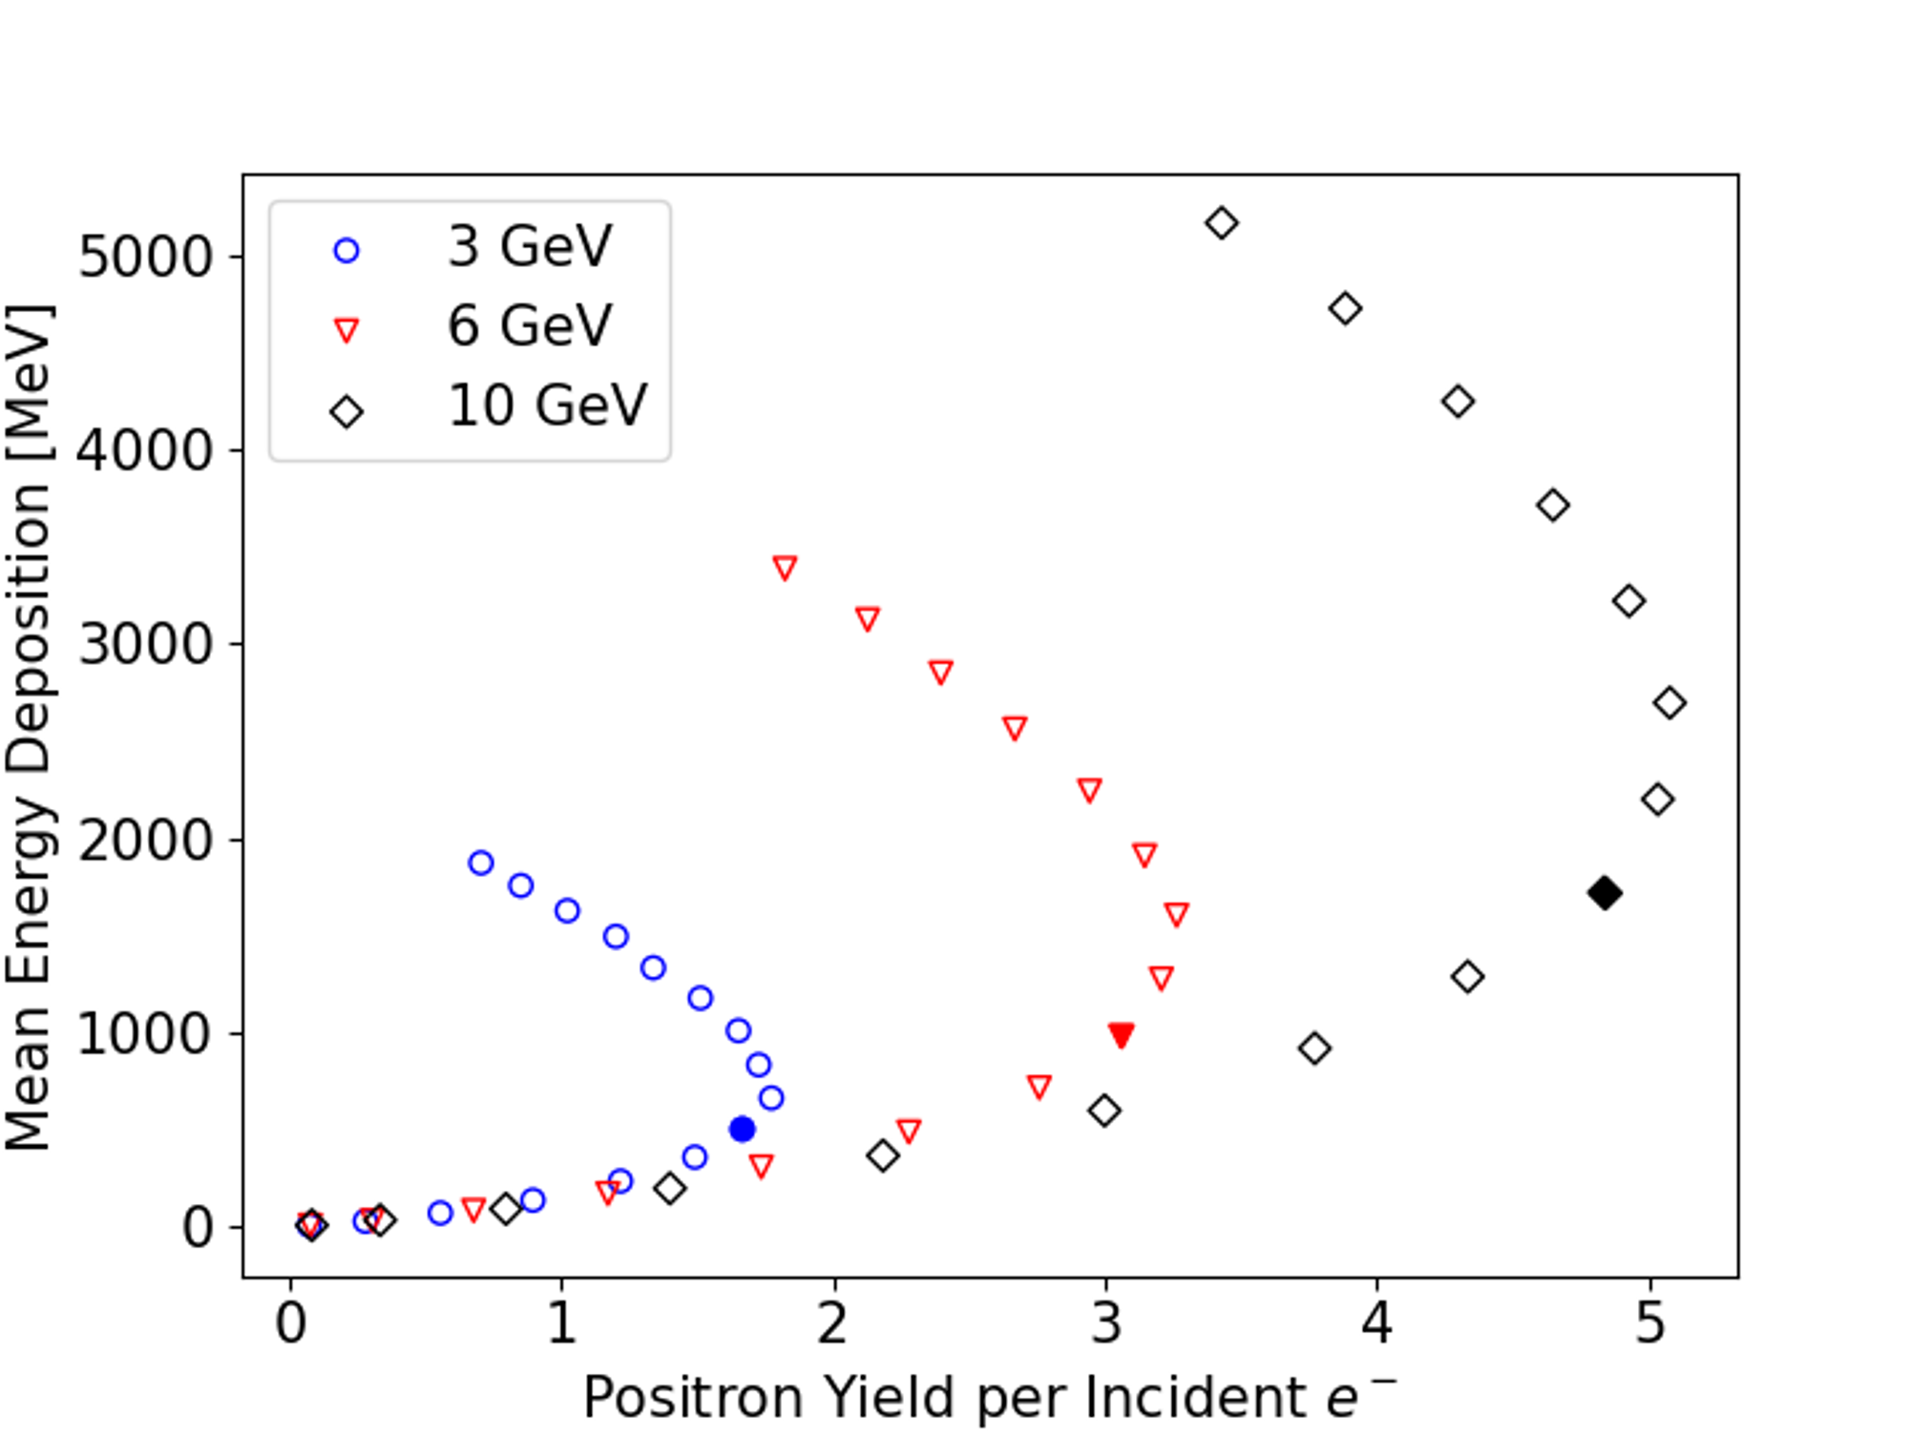
LXe energy deposition caveats
Large drop in Energy Dep. for small losses in Yield
Each point represents a different radiation length of the LXe target.
(Filled-in points indicate operating radiation length for LXe)
Mean energy deposition in LXe target per incident electron as a function of positron yield at three different beam energies.
US-Japan Collaboration Meeting, Feb 26, 2025
Varverakis, et al. (2023). A liquid xenon positron target concept, NIM-A (Vol. 1053, p. 168329). 10.1016/j.nima.2023.168329

Slide 9
Spatial profiles of energy deposition
Simulations of LXe + windows in G4Beamline
Notable simulation parameters
3 GeV e– beam
1,000 macro particles
LXe dimensions (x,y,z): 7 cm x 7 cm x 10 cm (3.5 rad. lengths)
LXe sliced into 245,000 rectangular prisms (0.1 cm x 0.1 cm x 0.2 cm)
Windows
Beryllium (Be) and aluminum (Al) disks were tested, each at thicknesses of 0.5 mm and 2 mm
Windows were split into “cubes” (0.1 cm x 0.1 cm x `window thickness`)
Data collection
Obtained energy deposition in each volume chunk (LXe, entrance window, exit window)
Results scaled to ILC parameters (2.5E10 e¯/bunch @ 1312 bunches/train)
Key figure of merit is energy deposition density (energy per unit mass: J/g)
US-Japan Collaboration Meeting, Feb 26, 2025

Slide 10
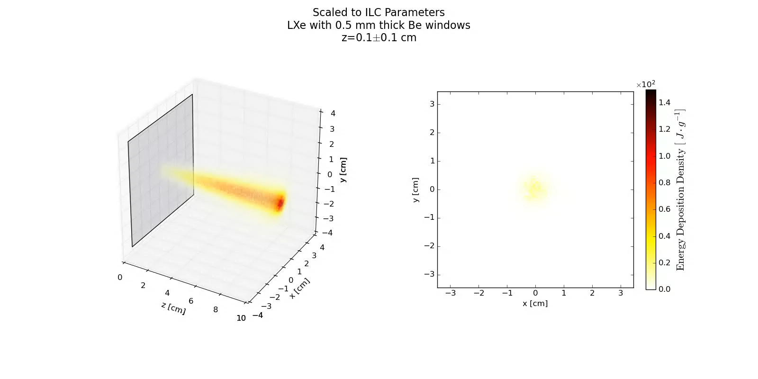

E_{dep} density distribution in LXe
Ideal scenario E_{dep} density (EDD) < peak EDD (PEDD = 96.2 J/g)
US-Japan Collaboration Meeting, Feb 26, 2025

Slide 11
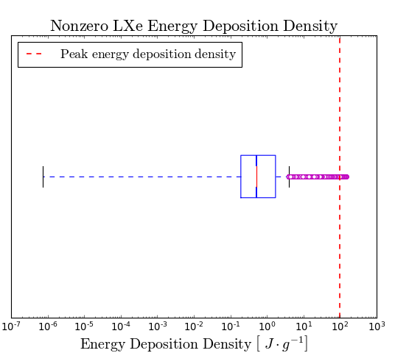
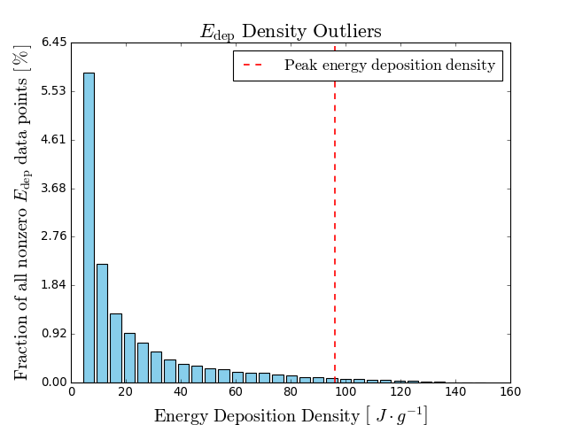
E_{dep} density statistics in LXe
Outliers make up < 15% of all nonzero E_{dep} data
0.36 % of the data is above PEDD (96.2 J/g)
US-Japan Collaboration Meeting, Feb 26, 2025

Slide 12
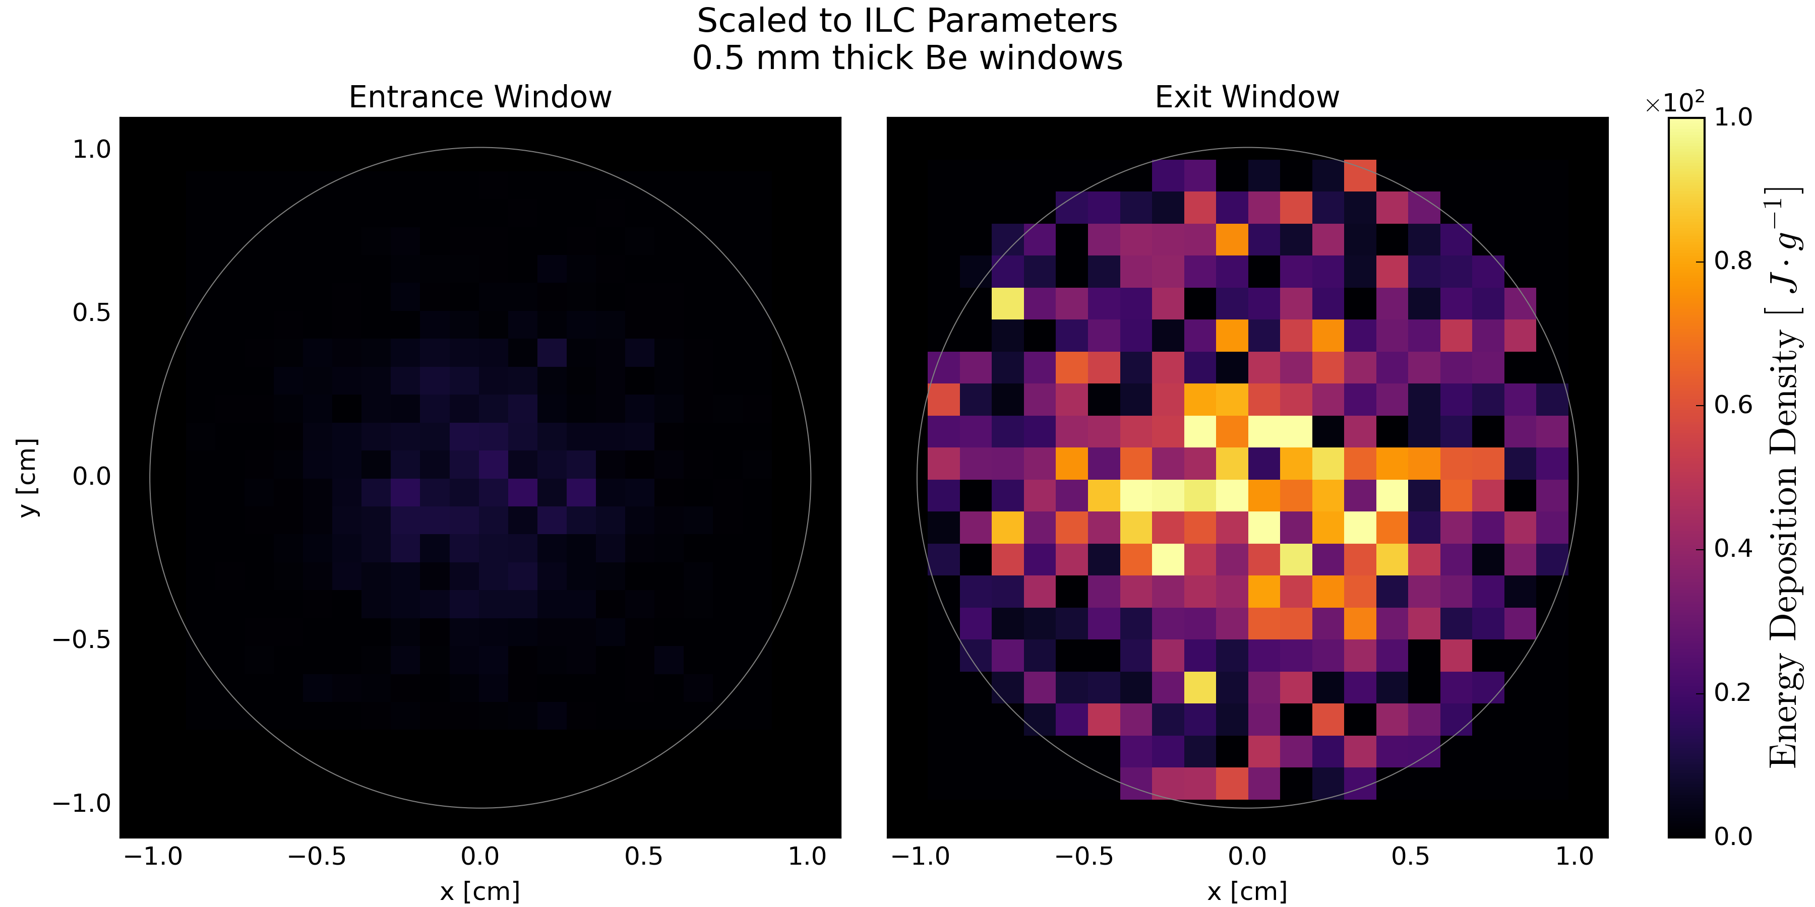
E_{dep} density in 0.5 mm-thick Be windows
PEDD for solid metals: 35 J/g
Max EDD in Entrance window < PEDD
US-Japan Collaboration Meeting, Feb 26, 2025

Slide 13
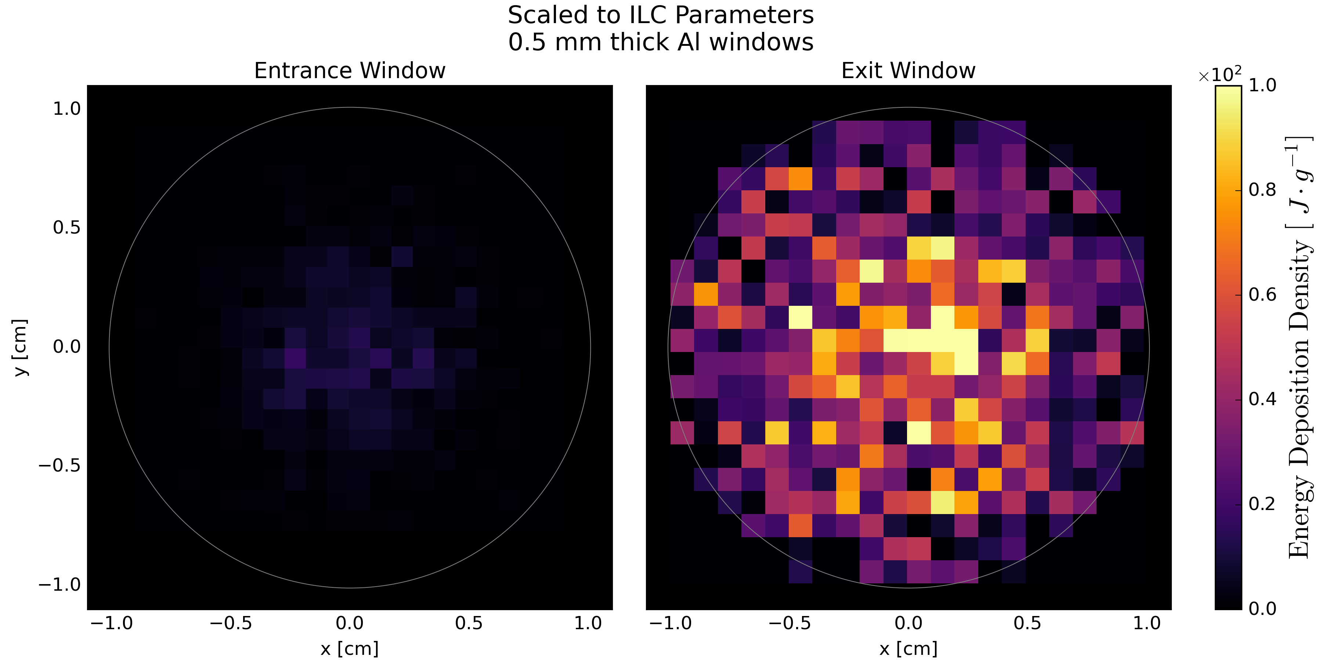
E_{dep} density in 0.5 mm-thick Al windows
PEDD for solid metals: 35 J/g
Max EDD in Entrance window < PEDD
US-Japan Collaboration Meeting, Feb 26, 2025

Slide 14
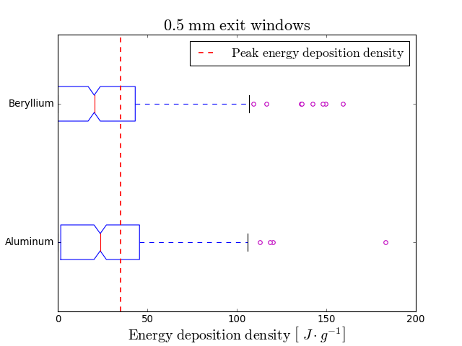
EDD in exit windows exceeds threshold
EDD in exit window exceeds PEDD for both materials
US-Japan Collaboration Meeting, Feb 26, 2025

Slide 15
LXe Containment Considerations
Simulations show that Be and Al disks are not suitable LXe exit windows for application at ILC-type colliders.
→ An alternative to Be/Al windows must be determined.
Main Design Constraints 1. Containment vessel must withstand high pressures due to LXe vaporization (~300 kPa) 2. LXe must be able to flow through the vessel and evacuate vaporized xenon 3. The flow rate of LXe must be high enough to account for vaporization so that only fresh LXe interacts with the electron beam 4. Target chamber must endure sustained temperatures of ~165 K (LXe liquid temperature) 5. Electron beam and resulting EM shower must be able to enter/exit the chamber with minimal interaction (and energy deposition)
US-Japan Collaboration Meeting, Feb 26, 2025

Slide 16
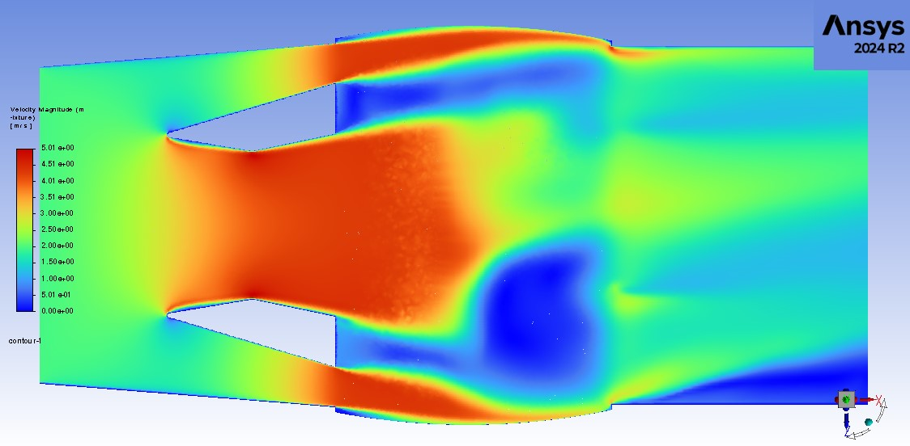
Next Steps
Current questions and ongoing work • What is the optimal LXe flow injection structure? → CFD simulations will use recent G4Beamline results to determine optimal LXe flow • Does the LXe experience turbulence at certain flow rates? • How does the vaporized xenon interact with the LXe? • Where/when does the LXe vaporize and does it create shock waves? → CFD modeling of the LXe will help answer these questions. Possible next steps Couple G4Beamline simulations to beam capture and transport models (e.g., GPT & ELEGANT) to fully simulate the target-to-damping ring design. Unresolved questions • Is a LXe cryo-jet a possibility (no containment vessel at IP)?
• How does the cost of implementing/maintaining the LXe target compare to the replacement/maintenance costs of solid targets?
S. Dusa, JLab
US-Japan Collaboration Meeting, Feb 26, 2025

Slide 17
Summary
Liquid xenon is a promising candidate for use as a positron source in future linear collider application.
Why? 1. LXe is non-toxic 2. LXe has many appealing properties that make it relatively easy to work with (e.g., high-temp. liquid, nonreactive) 3. LXe has a short radiation length & high energy deposition threshold 4. LXe is not susceptible to long-term degradation 5. Positron output is similar to solid targets (comparable yields and energies) Future work will elaborate on the findings of our simulations to build a better picture of the LXe target in action.
US-Japan Collaboration Meeting, Feb 26, 2025

Slide 18
Acknowledgements/References
Work supported by the U.S. Department of Energy under Contract DE-AC02-76SF00515 and the National Science Foundation (Grants No. PHY-1535696 and No. PHY-2012549).
Source code GEANT4 simulations https://github.com/MaxVarverakis/LiquidXenonSims.git G4Beamline simulations https://github.com/MaxVarverakis/G4Bl-LXeSims
References [1] V. Bharadwaj, et al., in PACS2001. Proceedings of the 2001 Particle Accelerator Conference (Cat. No.01CH37268), Vol. 3 (2001) pp. 2123–2125 vol.3. [2] Simulations of the Rotating Positron Target in the Presence of OMD Field, S. Antipov, et al., DOI: 10.1109/PAC.2007.4440617 [3] Workman R.L., et al., Particle Data Group Collaboration, Rev. particle phys., PTEP, 2022 (2022), p. 083C01, 10.1093/ptep/ptac097 [4] Schultz D.C., Batygin Y.K., Bharadwaj V., Sheppard J.C., NLC positron target heating (2002) [5] J.C. Liu, T. Kotseroglou, W.R. Nelson, D.C. Schultz, Polarization study for NLC positron source using EGS4, in: 2nd International Workshop on EGS4, 2000, pp. 115–123. [6] S. Agostinelli et al. (GEANT4), Nucl. Instrum. Meth. A 506, 250 (2003). [7] Muons (2011). G4beamline.
US-Japan Collaboration Meeting, Feb 26, 2025

Slide 19
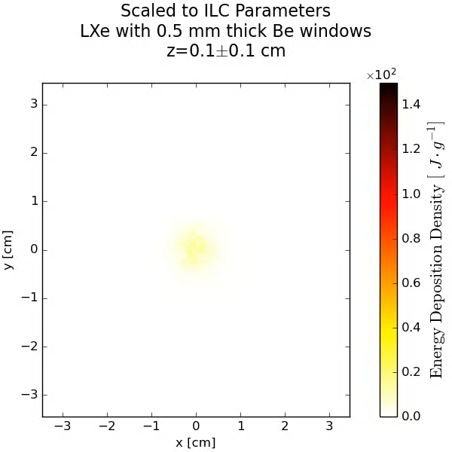
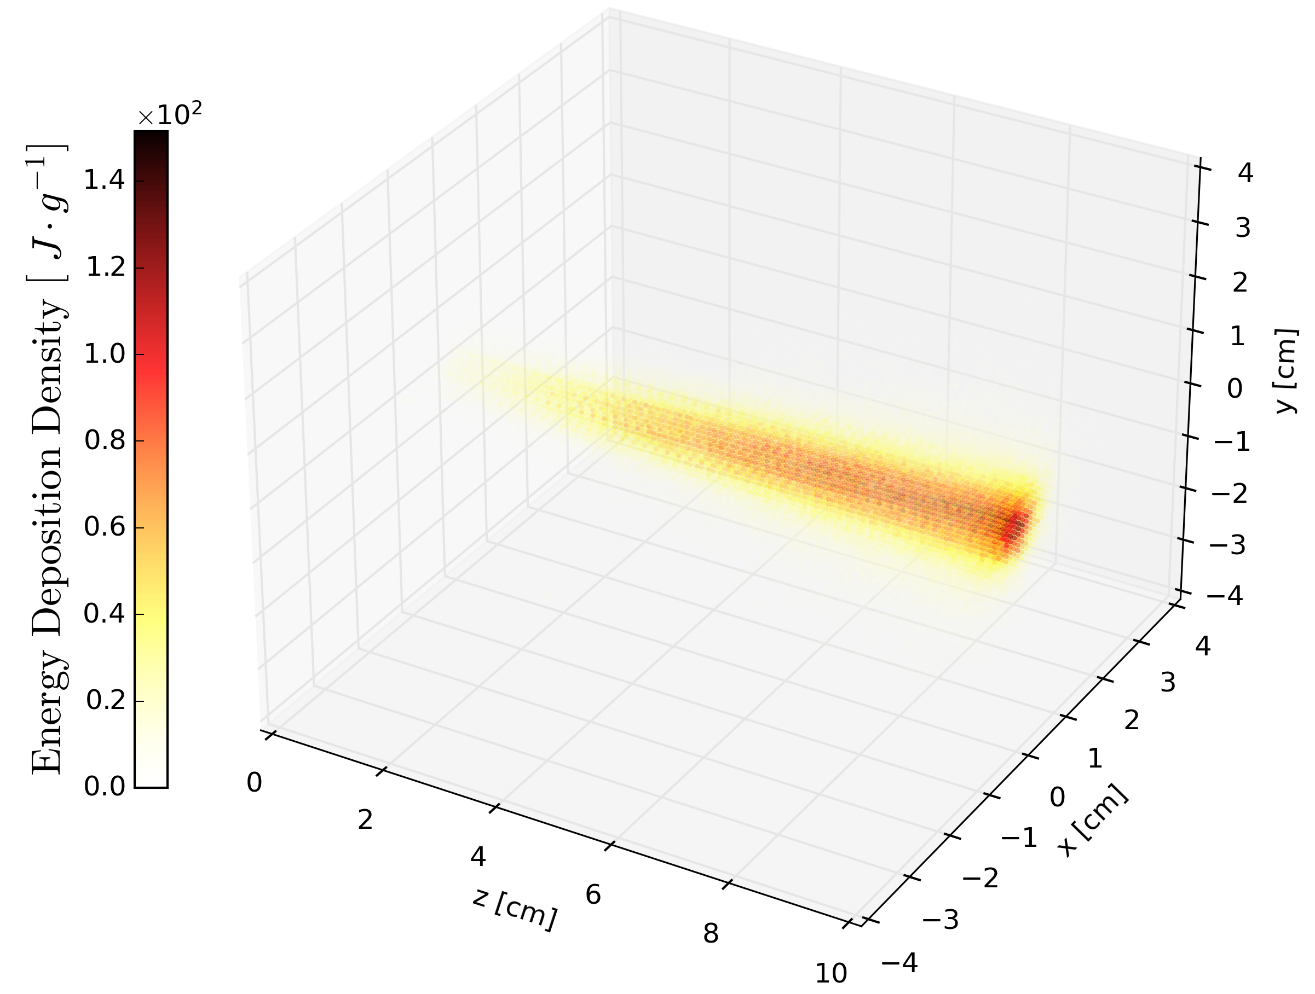
E_{dep} density distribution in LXe
Max E_{dep} density ~ 152 J/g
US-Japan Collaboration Meeting, Feb 26, 2025

Slide 20
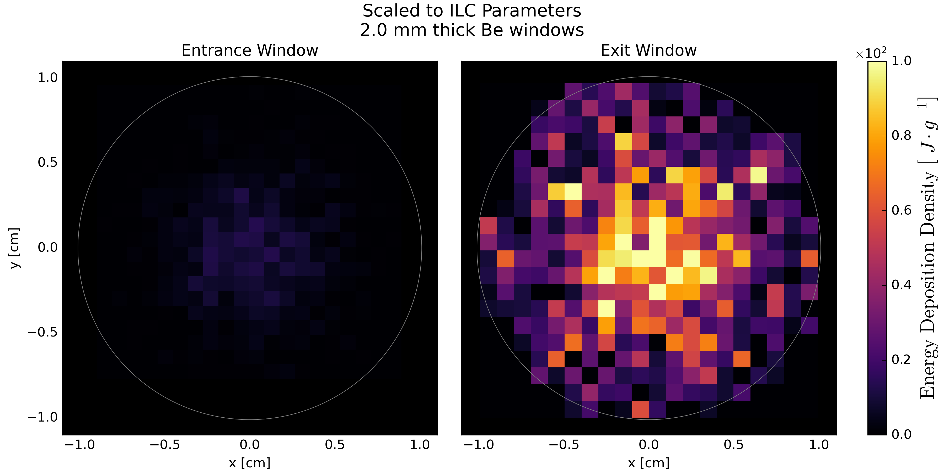
E_{dep} density in 2 mm-thick Be windows
US-Japan Collaboration Meeting, Feb 26, 2025

Slide 21
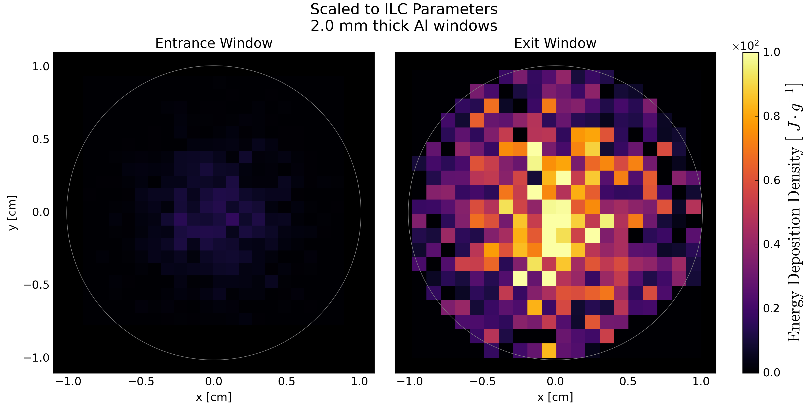
E_{dep} density in 2 mm-thick Al windows
US-Japan Collaboration Meeting, Feb 26, 2025

